Slide 1

Currency Exchange
Tutu Qafarli
Aflatun Valibayli
Intiqam Nagiyev
Taleh Mammadov

Slide 2



Short Description
Synchronized with Internet
Simple, accurate and fast
Save exchange date

Slide 3
Used Technologies
Spring Boot
Spring MVC
Spring Data
Thymeleaf
Ajax
HTML, CSS, JS
JPA
Hibernate
PostgreSQL
1
2
3

Slide 4
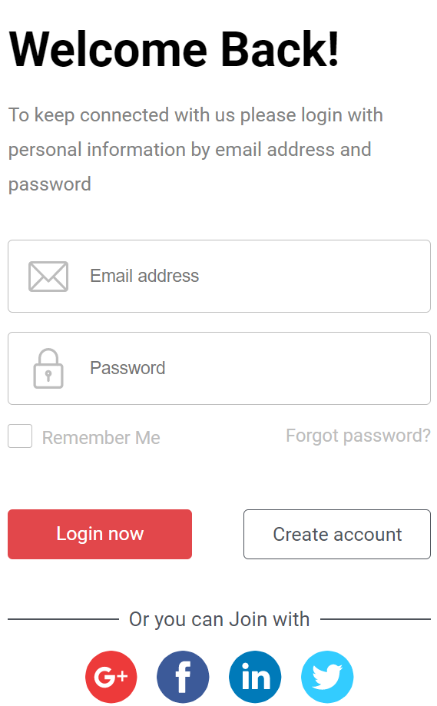
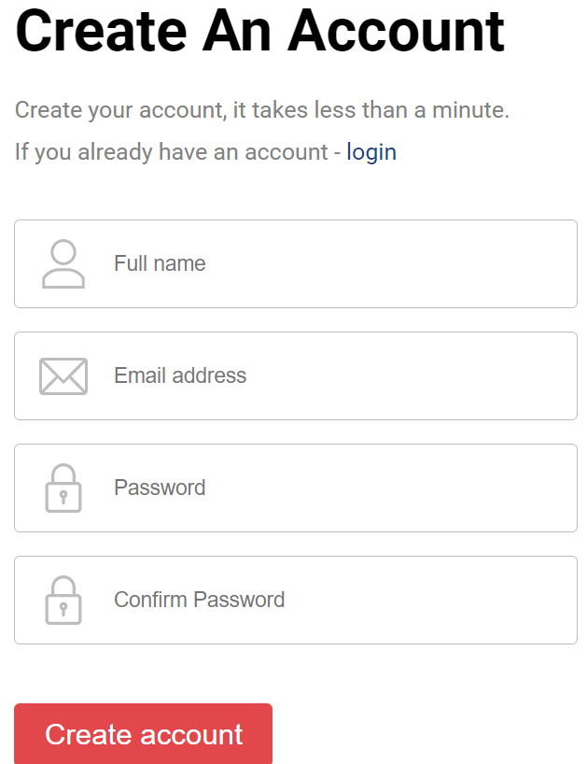
Login & Registration

Slide 5
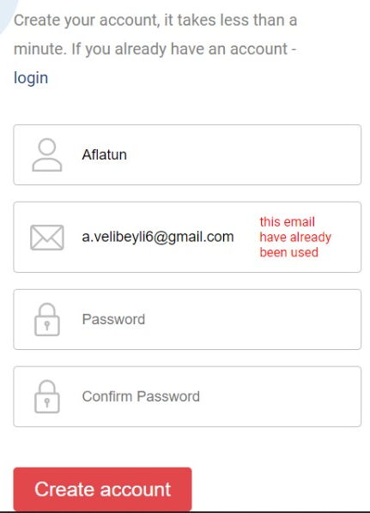
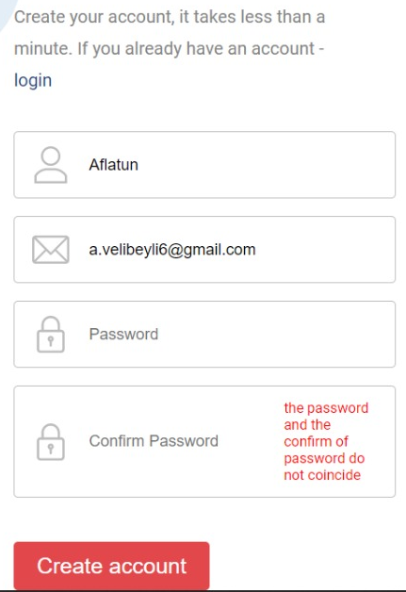
Validator

Slide 6
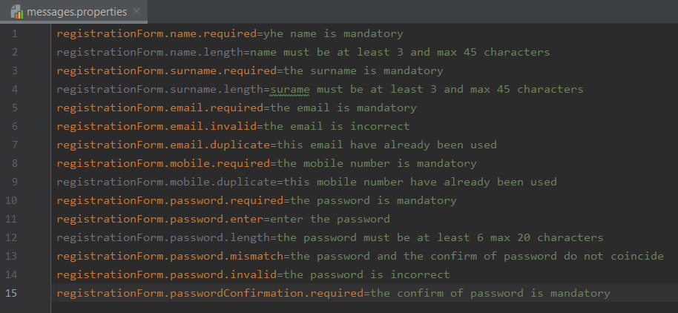
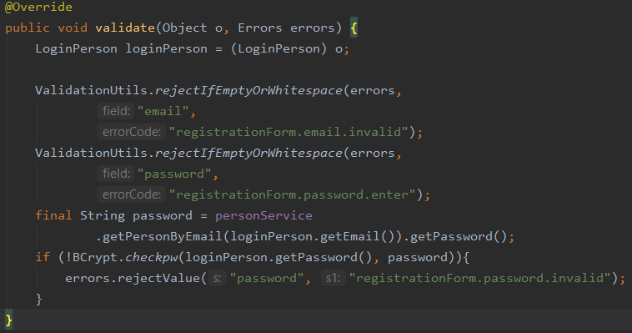
Back-end

Slide 7
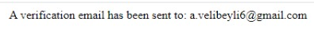
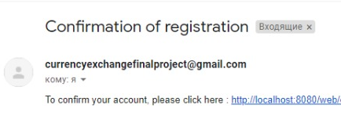
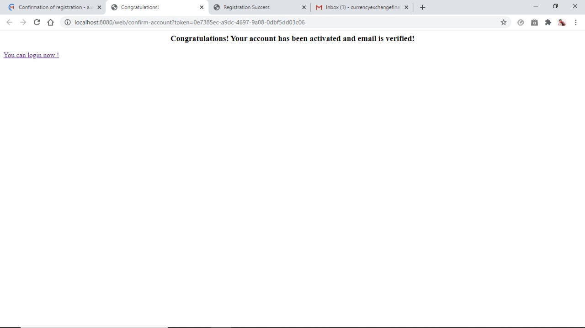
Email Confirmation

Slide 8
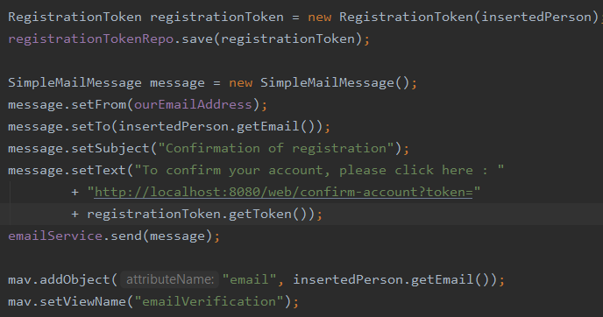
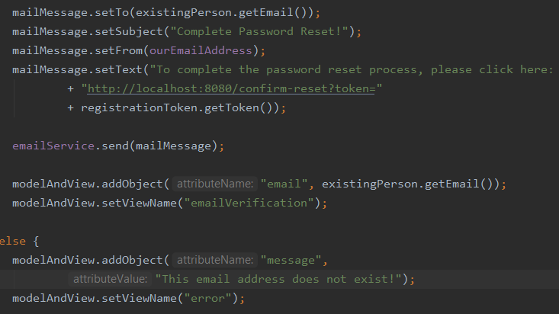
Back-end

Slide 9
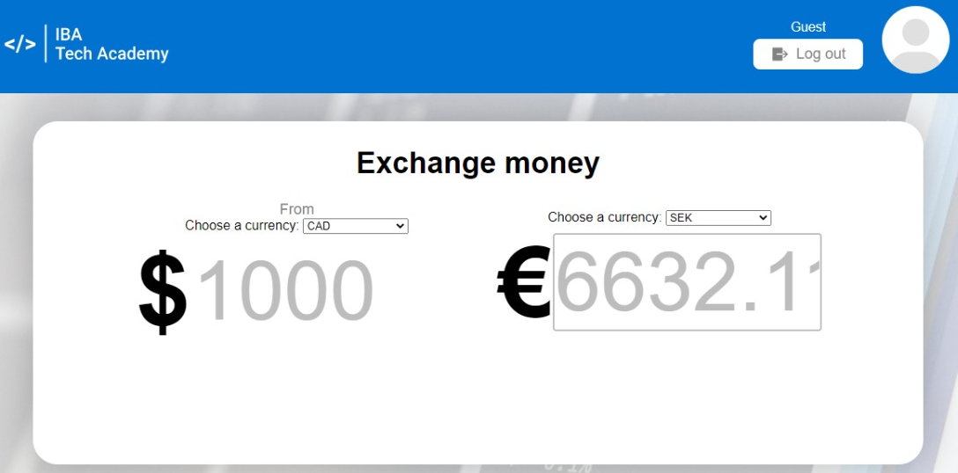
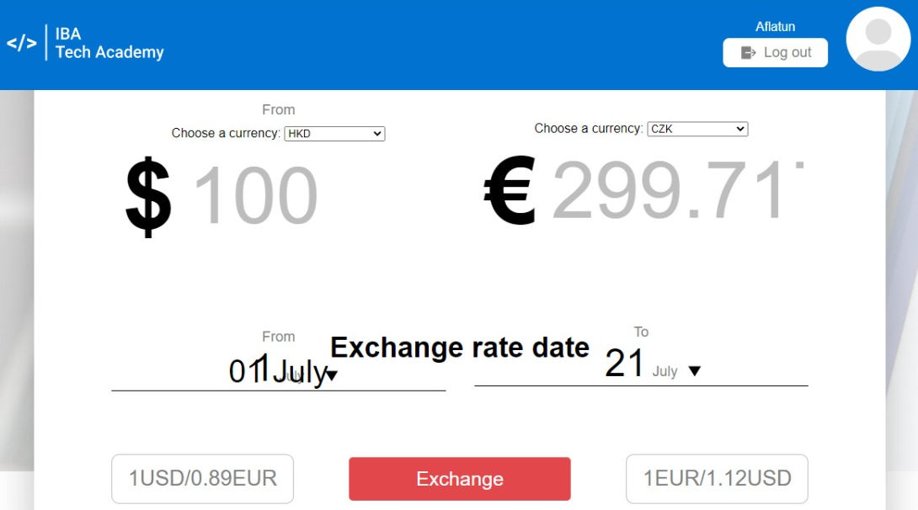
Main-Guest & Main-Authorized

Slide 10
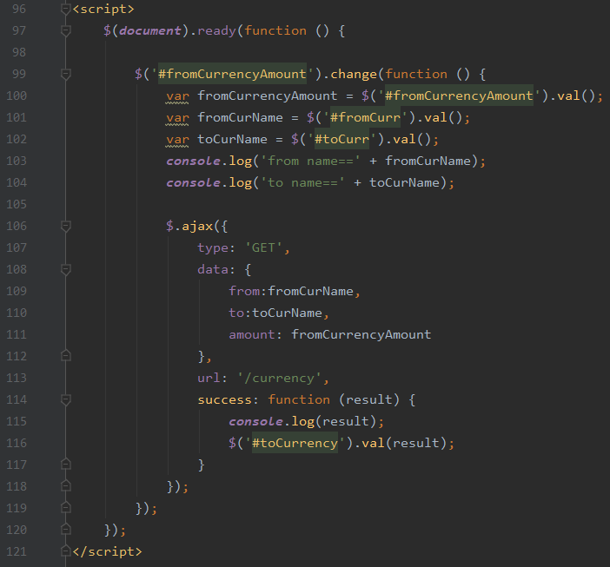
Ajax

Slide 11
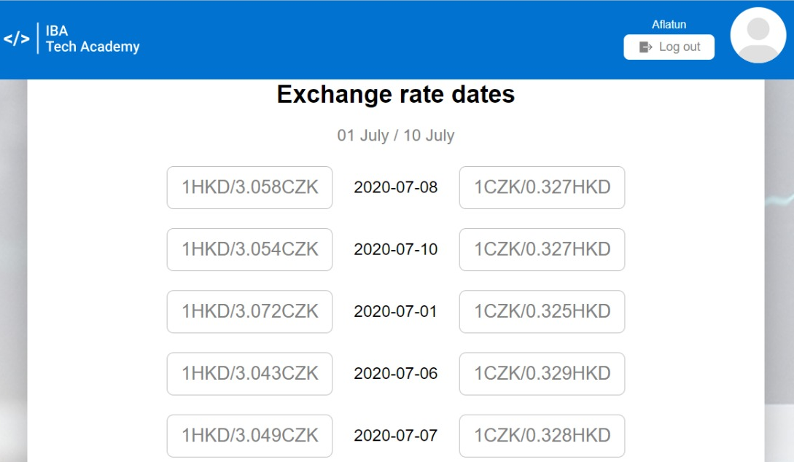
Rate Dates

Slide 12
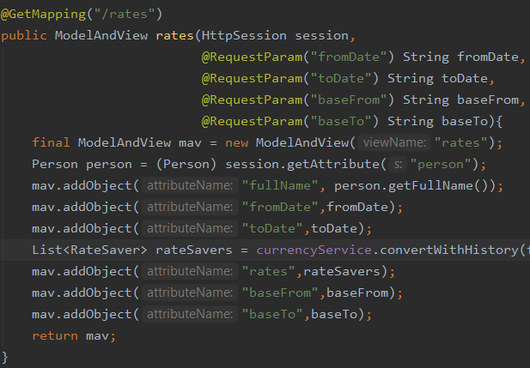
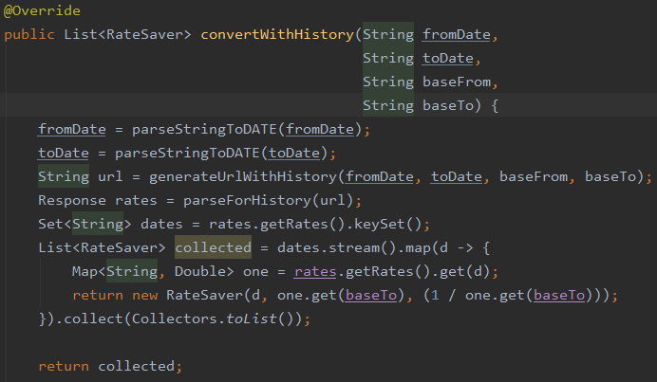
Back-end

Slide 13
Links
Template Editing Instructions and Feedback

Slide 14
Thanks a lot for your attention!

